Slide 1

Technological Aspects
Explore the fascinating world of technological aspects that shape our lives. Discover the cutting-edge technologies, tools, and innovative solutions that are revolutionizing industries.

Slide 2
Technologies and Tools
Artificial Intelligence
Blockchain
Discover how AI is transforming industries, from healthcare to finance, by enabling more efficient processes and personalized experiences.
Explore the decentralized power of blockchain technology that is revolutionizing the way we store, share, and verify data securely.
Internet of Things
Virtual Reality
Unlock the potential of IoT, connecting devices and the physical world, enabling smart homes, cities, and industries for a more efficient future.
Dive into the immersive world of VR, blurring the lines between reality and imagination, and revolutionizing entertainment, training, and communication.

Slide 3

Technical Challenges and Solutions
1
Data Security
Delve into the challenge of ensuring data privacy and explore innovative solutions such as encryption and biometric authentication.
2
Scalability
Discover how organizations tackle the challenge of scaling their systems to accommodate increasing demands and achieve seamless user experiences.
3
Interoperability
Unveil the complexities of integrating technologies and systems, and explore solutions that enable seamless communication and data sharing.

Slide 4
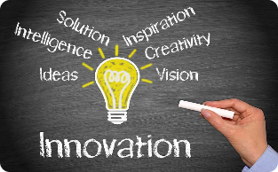

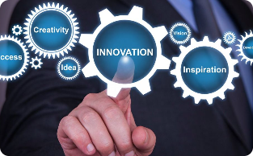

Innovation in Technology Application
Medical Field
Transportation
Education
Smart Cities
Explore how technology is revolutionizing healthcare, from telemedicine and robotic surgeries to personalized treatments and AI diagnostics.
Uncover the latest advancements in transportation technology, including autonomous vehicles, smart traffic management, and hyperloop systems.
Learn how technology is reshaping education through online learning platforms, interactive tools, and personalized learning experiences.
Discover how smart city technologies enhance urban living with efficient energy management, intelligent infrastructure, and data-driven decision making.

Slide 5
Future Trends
5G and Connectivity
Artificial Intelligence Advancements
Robotic Process Automation
Unleash the potential of 5G technology and its impact on fast internet connectivity, IoT, autonomous vehicles, and virtual reality.
Explore the future advancements in AI, including deep learning, explainable AI, and AI-powered automation for various industries.
Discover how RPA is transforming business processes by automating repetitive tasks, reducing errors, and enhancing efficiency.

Slide 6

Revolutionary Innovations
1
3D Printing
Witness the ability to create complex objects, from prosthetics to architectural models, using additive manufacturing.
2
Quantum Computing
Explore the potential of quantum computing to solve complex problems that are currently beyond the capabilities of classical computers.
3
Gene Editing
Discover how advancements in gene editing technology, such as CRISPR, are revolutionizing healthcare and agriculture.

Slide 7

Ethical Considerations
1
Data Privacy
2
Automation Impact
3
Algorithm Bias
Discuss the importance of privacy regulations and ethical considerations when collecting and utilizing personal data.
Examine the ethical implications of automation on the workforce, job displacement, and the need for retraining and upskilling.
Address the challenges and impact of algorithmic bias in decision-making processes and the need for fairness and transparency.

Slide 8

Conclusion
Technological advancements are shaping our present and future. By embracing innovation and addressing ethical considerations, we can harness the full potential of technology to create a better world.

